Slide 1
Mobile application development.
Directory Structure of An android App

Slide 2
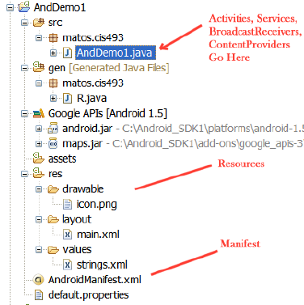
Directory structure of android Application
The Android platform organizes a mobile application in a specific directory tree structure as follows

Slide 3
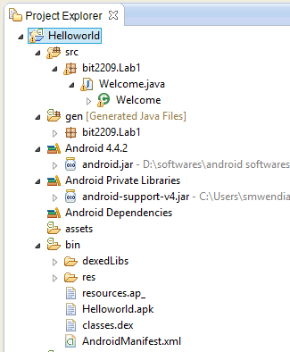
Lab1: Helloworld directory tree structure

Slide 4
Directory structure of android Application
project's root directory consists of the following items :
  1. src/, is a folder for holding Java source code for the application.
  2. Assets/ folder is used to store static files that will be packaged with the application for deployment onto the device.
  3. AndroidManifest.xml file describes application components such as activities, views, intents, services, Notifications and content provider etc.

Slide 5
Directory structure of android Application
gen/ -contains the auto generated java files
They are generated by Android development tools(ADT).
An example is R.java, which contains a number of constants tied to the various
resources in res/ directory
R.java should not be modified since it contains unique IDs for application resources
Uses findViewById and Resources object to get access to the resources
Examples:
  Button b = (Button)findViewById(R.id.button1)
  Ex. getResources().getString(R.string.hello));

Slide 6
res/ directory tree.
  res/ is a folder for holding application "resources” that get
  packaged with the compiled Java in the application.
  subdirectories of res/ directory include:
  1. drawable/ for images (PNG, JPEG, etc.)
  2. layout/ for XML-based UI layout specifications
  3. raw/ for storing general-purpose files (e.g a file of Account information)
  4. values/ for storing data files such as strings, dimensions, etc
  5. xml/ for storing other general-purpose XML files

Slide 7
bin/ directory
Bin/ directory is used folder for holding the application once it is compiled.
It consists of the following items.
1. classes/ directory holds the compiled Java classes
2. classes.dex file for holds the executable code created from compiled Java classes
3./yourapp.apk is the actual Android application (where yourapp is the name of your application)
The .apk file is a ZIP archive containing the .dex file, the compiled resources , any un-compiled resources (such as res/raw/) and the AndroidManifest.xml file.

Slide 8

End
Thank You
Questions

